Slide 1
UNIT - V
WEB APPLICATIONS

Slide 2
What is a Web Application?
It is also known as an ASP.NET Application
Its similar to a Windows Application in some ways, particularly from the user’s point of view
  Both applications can have one or more forms, and controls can be placed on them to provide the graphical-user interface
  The program can be written respectively to provide functionality to these application
  The similarities end here

Slide 3
Client/Server Architecture
It is designed to run on the Internet
It is located in a Web server and can be accessed remotely by the user through a web browser but the application is actually running on the server.
Thus, a two-way communication takes place between the Client(web-browser) and the Server.
This type of communication provides means for the application to respond to the user’s actions and take input from the user

Slide 4
Server Side
The web application’s code runs on the server and sees the values of the controls only when the client submits them (by clicking a button and submitting the form to the server).
The web application is not running at all times on the server. It starts every time the client submits a request to the server. It runs for a few seconds, generates a new page, and then terminates.

Slide 5
ASP.NET Technology
It is based on the older ASP(Active Server Pages) in many ways
It offers significant improvements over ASP.NET like
  Performance
  Security
  Deployment
  State Management
ASP applications can be migrated to ASP.NET
ASP applications can also coexists with ASP.NET

Slide 6
How it works?
To access a resource or in our case a web application, we provide the respective URL(Uniform Resource Locator) in the web browser.
For example:
http://www.microsoft.com/index.htm
There are three parts to this URL
  http:// -Protocol used
  www.microsoft.com -identifies the specific computer to which the request is directed to
  Index.htm -resource/file name

Slide 7
How to navigate ASP.NET applications?
The files for such applications have the extension .aspx
For example
http://www.microsoft.com/myapp.aspx

Slide 8
Parts of a Web Application
At the heart of such applications is a Web form
A form represents one page or window in the application
Each web form consists of HTML tags and VB statements. The HTML part of the page is transmitted as is to the client, when it is rendered by the browser. The VB code resides on the server and will be executed automatically when certain events are fired.
In reality, when a user clicks a button on the form, a postback action occurs. In such a case, the client sends the data on the current form to the server, and the server executes the appropriate event handler.

Slide 9
HTML
Hypertext Markup Language (HTML) is the language used to prepare most documents for online publication.
HTML documents are also called Web Pages; a page is what you see in your browser at any time.
The simplest component of the Web is HTML, which is a basic language for formatting documents that are displayed in a Web browser.
HTML is made up of text-formatting tags that are placed in a pair of angle brackets.

Slide 10
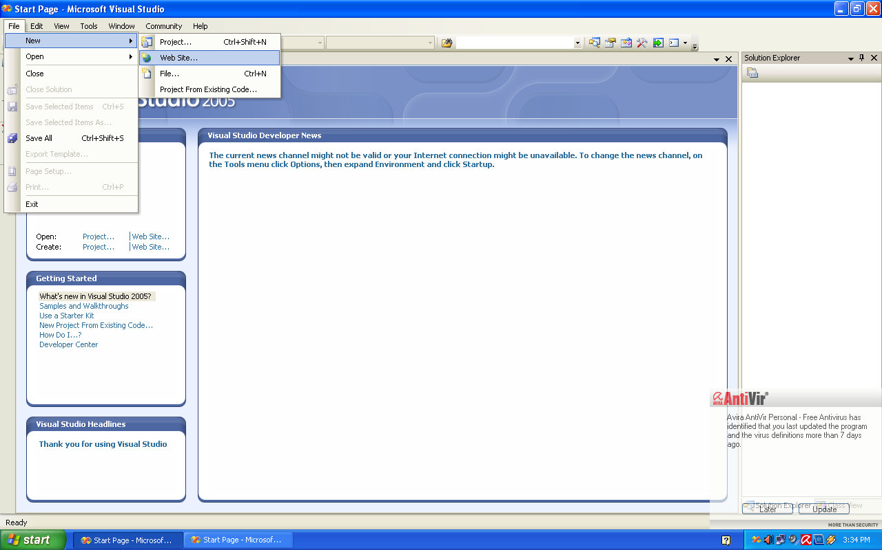
Getting Started
Select New->Web Site

Slide 11
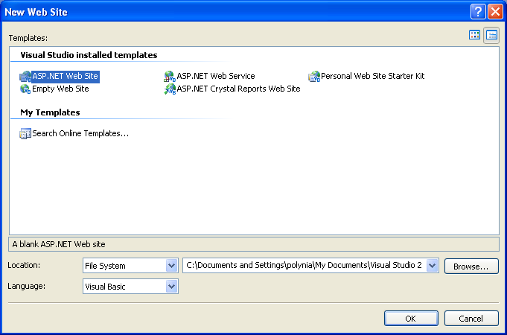
Select ASP.NET Web Site

Slide 12
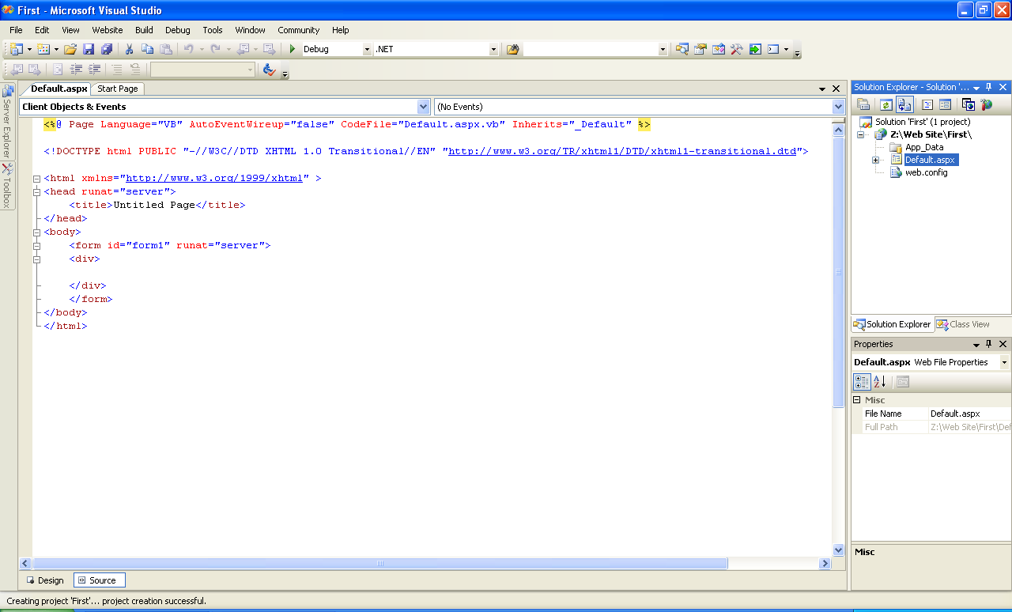
ASP.NET Application IDE
Right-click and choose View Designer to go to Design Page
Click on Design Tab to go to Design Page of your application

Slide 13
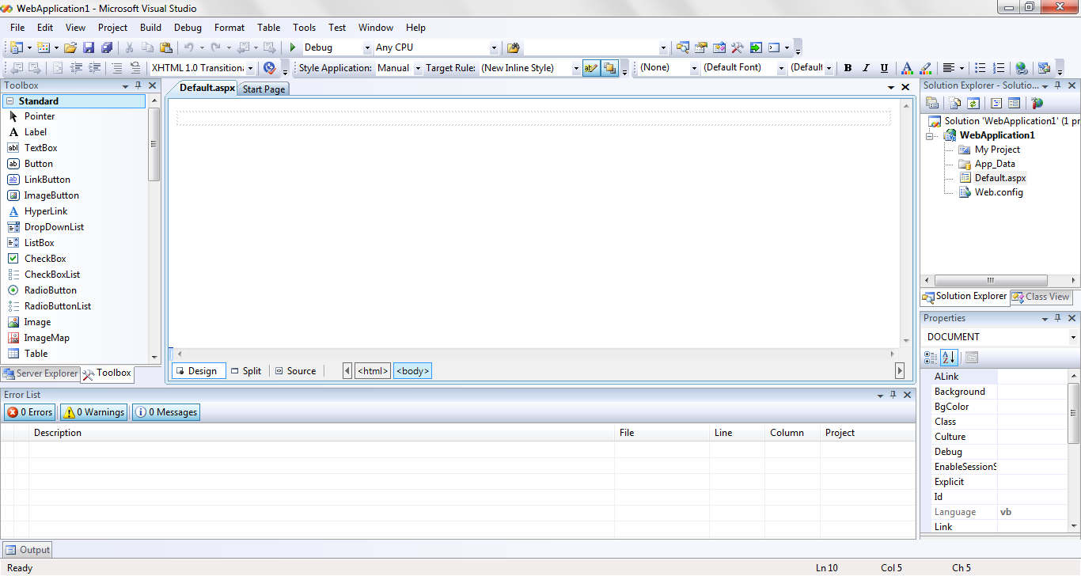
Web Application IDE

Slide 14
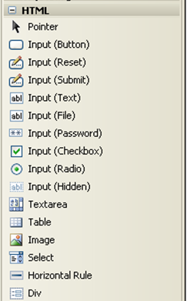
HTML Controls in ToolBox

Slide 15
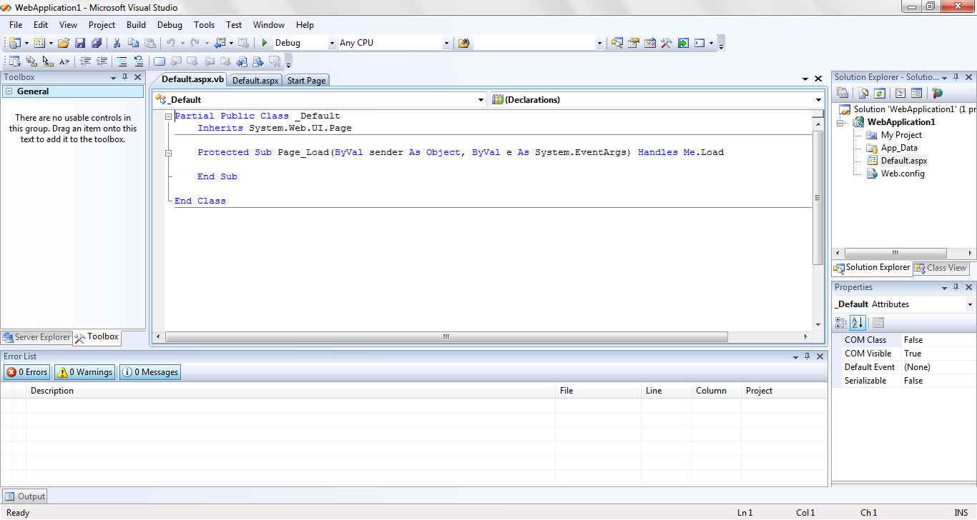
Writing Code(.aspx.vb)

Slide 16
Note*
While renaming the Default.aspx, the new name must be specified along with the extension
By default, the Page Load Sub appears in the code. Used for initialization purposes during the loading of the web form
To run the application, press Ctrl+F5. No EXE file is created during compilation for such application, it requires a web browser to run

Slide 17
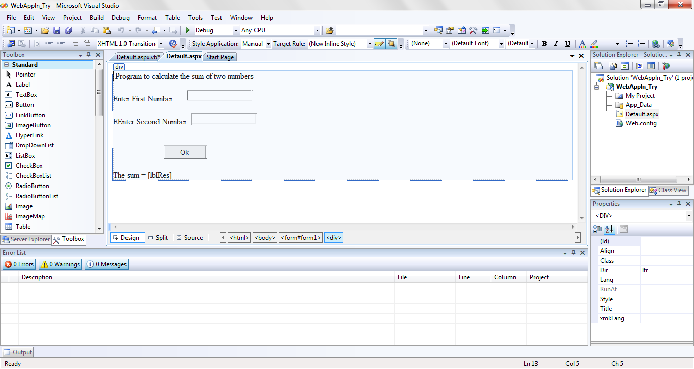
Web Application to Add two numbers

Slide 18
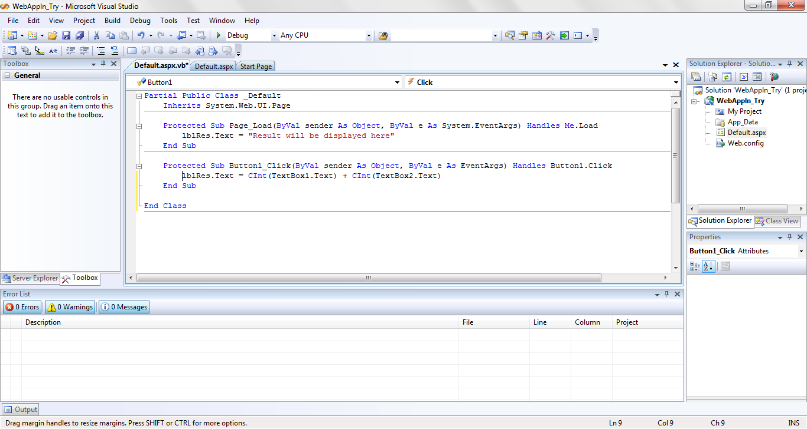

Slide 19
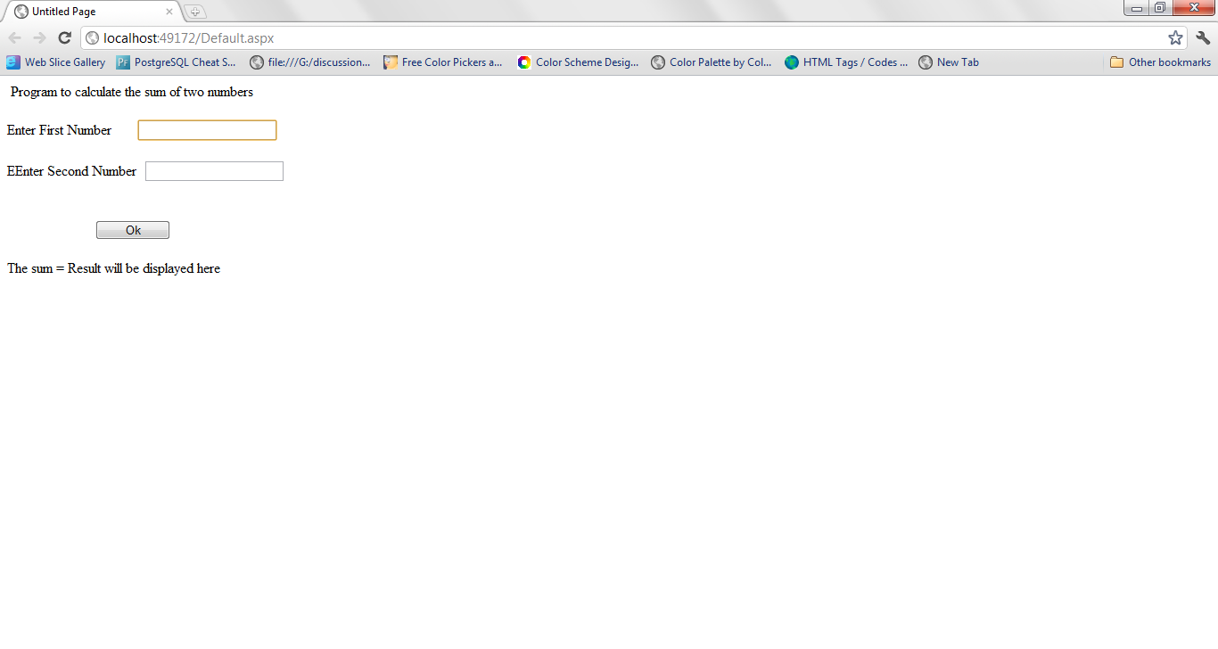
Output Window

Slide 20
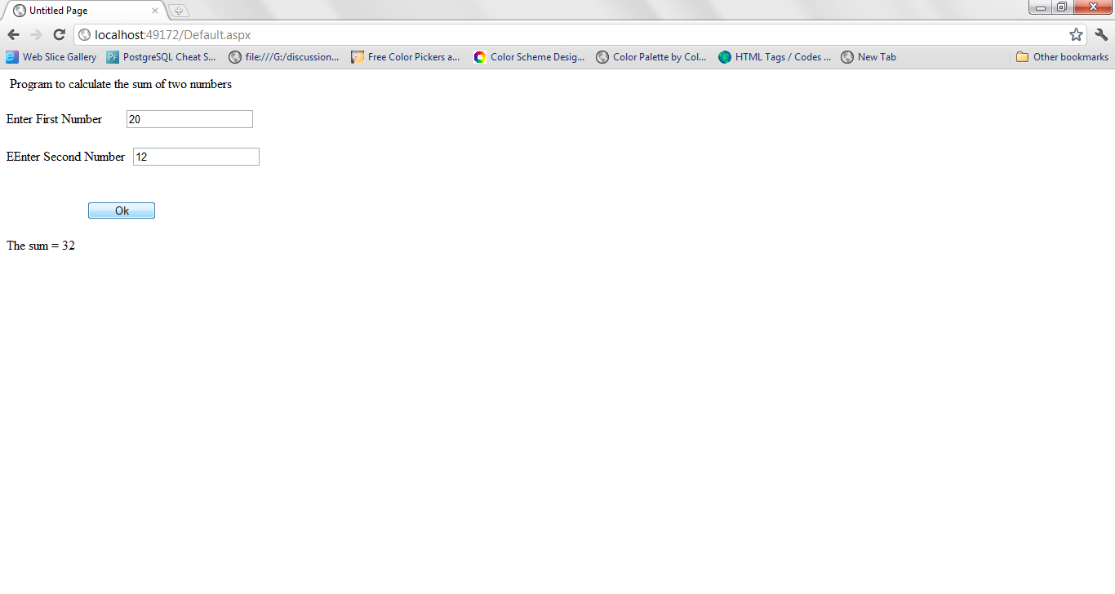
Result Screen

Slide 21
Worksheet
  Create a Web Application for calculating Simple Interest. Take the required input from the user, principle/amount, rate, & time in years
  The amount must be greater than zero
  The interest rate must be between 1(0.01) and 20(0.20)
  The time must be greater than 1
  Display the result accordingly

Slide 22
Local Server
For ASP.NET development locally, we require a Web Server to be installed in our machines
The URL used in the Web Browser is
  http//localhost/mywepp/webform1.aspx
  or
  http//127.0.0.1/mywepp/webform1.aspx

Slide 23
WEB CONTROLS

Slide 24
Web Controls
When we design a web form, the ToolBox displays by default the tab with the Web controls.
Many of these controls – the simple Web controls – have equivalent HTML controls.
The Web controls tab of the toolbox contains advanced controls, which are known as Rich Web Controls, among these are the Validation Controls

Slide 25
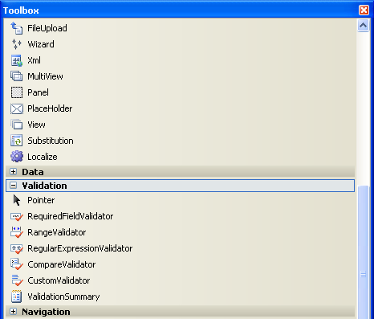
Validation Controls

Slide 26
Validation Controls
The ASP.NET validation controls are designed for one task validation
To simplify the validation of the data submitted to the server, ASP.NET provides five controls, collectively known as validation controls, and
Another control that displays the errors detected by the five validation controls.

Slide 27
The Five Controls
RequiredFieldValidator – makes sure that the user has entered text or made a selection from a group of controls.
CompareValidator – compares the value of a control with a specific value or value of another control, by setting the Operator property to Equal, NotEqual, GreaterThanEqual, GreaterThan, LessThan, LessThanEqual, DataTypeCheck
RangeValidator – confirms that the value of the control falls within a specified range, by setting the properties MinimumValue and MaximumValue

Slide 28
The Five Controls
RegularExpressionValidator – compares a control against specific regular expression which is set in the ValidationExpression property
CustomValidator - allows you to supply your own validation logic

Slide 29
Common Properties of the 5 Controls
ControlToValidate- identifies control to be validated
ErrorMessage – specifies the message to be displayed if validation fails
Display- determines how the error message is displayed. Settings are None (Default), Static – space is allocated for the message in page layout, Dynamic- space will be allocated dynamically to the page
IsValid- Is True if associated control passes validation else False
Type – specifies datatype for validation. The values are first cast to this type before being compare, which is set to String by default.

Slide 30
ValidationSummary Control
This control is not used for validation , it automatically displays all the errors caught by the other validation controls on the form

Slide 31
Setting Properties
RequiredFieldValidator: mandatory to set ControlToValidate
CompareValidator: required to set
  ControlToValidate
  ControlToCompare OR ValueToCompare
  Operator
  Type
RangeValidator: required to set
  ControlToValidate, Minimum, Maximum, Type
RegularExpressionValidator: required to set
  ControlToValidate
  ValidationExpression

Slide 32
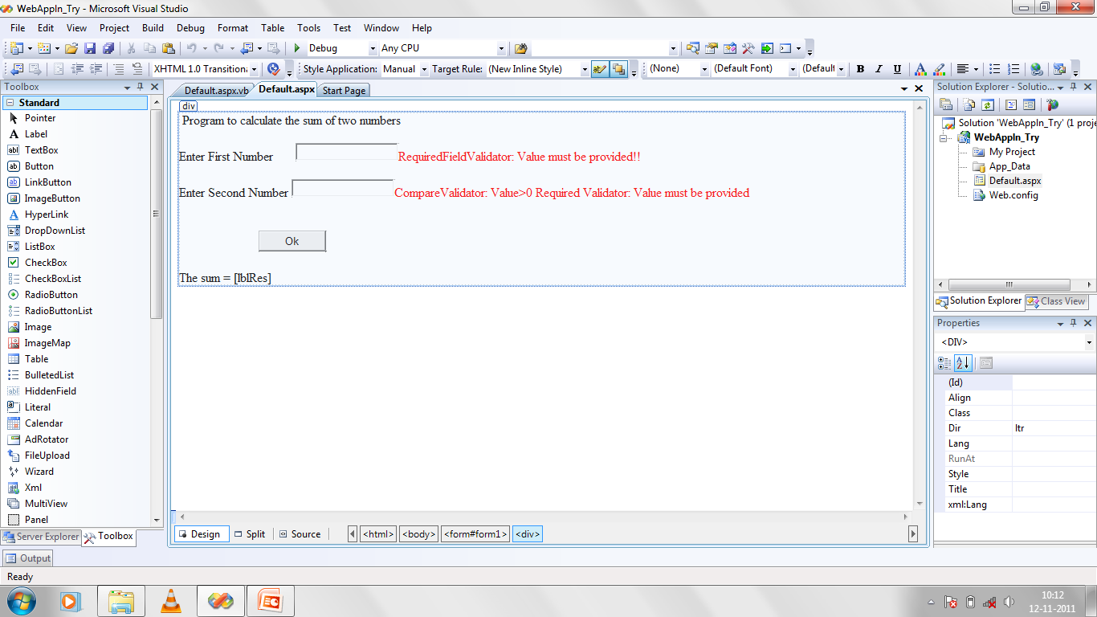
Example

Slide 33
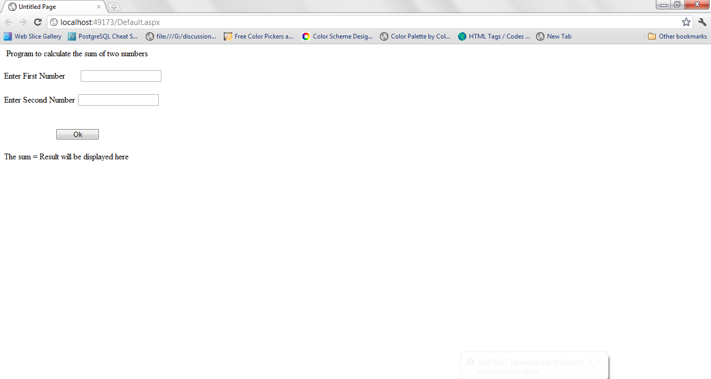
Page Loaded

Slide 34
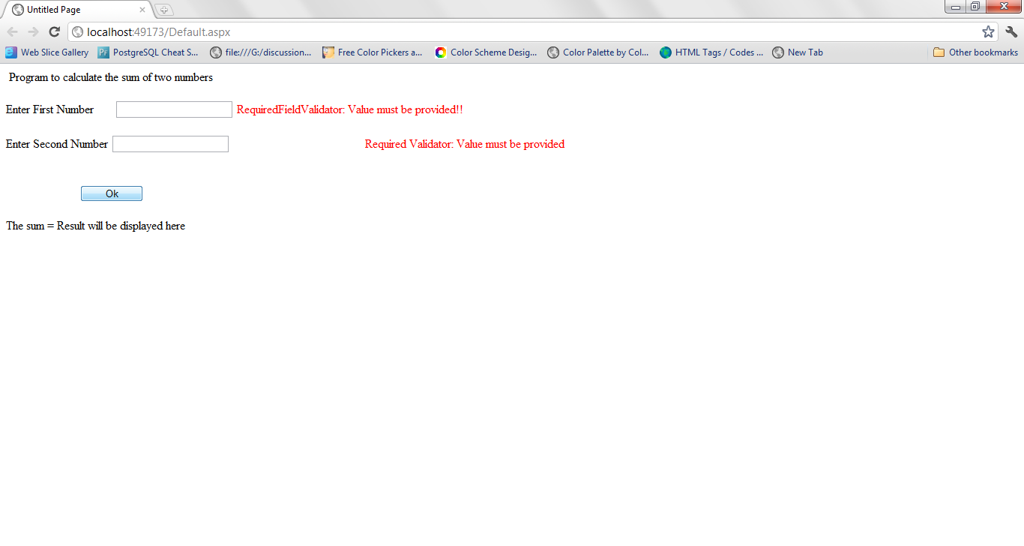
On submitting without providing values

Slide 35
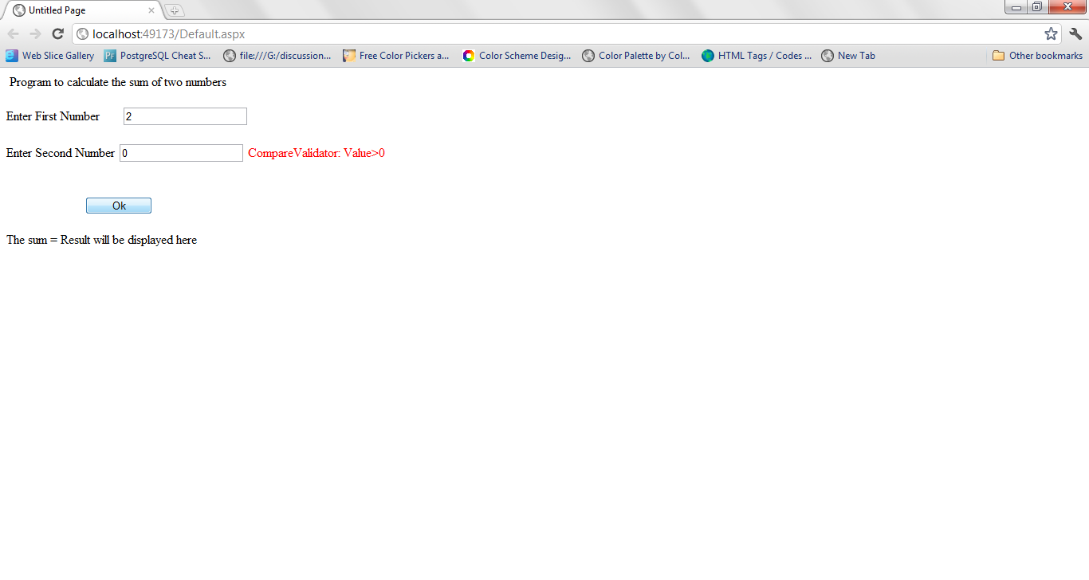
CompareValidator

Slide 36
Maintaining State
A major difference between ASP applications and Windows applications is that HTML pages (and, therefore, Web forms) are totally independent from one another.
If we want to persist some information between successive invocations of the same page, or multiple pages of the same application, we must do some extra work.
The information we want to maintain is known as the application’s state.
To maintain state, we can make use of the following:
  Session Object
  Cookies
  Embedded Hidden State

Slide 37
Session Object
There are several methods to maintain state across the pages of a Web application.
The simplest method is to create a few variables through the Session object.
You can access the Session object via the Session keyword.
  Syntax: Session(ItemName) = ItemValue
  Example:
  Session(“number”) = 3

Slide 38
Session Object
To retrieve data from the Session object, simply use:
  Session( ItemName) as an expression
Example:
Dim n as Integer =Session(“number”) ‘n=3
The Session object represents a specific session; its created when a new user connects to the server and released when the user leaves the site.
To clear information saved: Session.Clear()

Slide 39
Cookies
In the past, Web developers used to pass cookies and store them on the client computer.
However, many users are disabling cookies on their computers or may delete them, so we cannot rely on this technique for all clients.

Slide 40
Embedded Hidden Files
A very reliable method of maintaining state among multiple pages and requests is to embed hidden files in our pages and read them when the pages are submitted back to the client.
The hidden field is an HTML control and there is no equivalent web control.
This technique is used heavily by ASP.NET applications.

Slide 41
Page Object
The Page object represents the page (an ASPX file) requested by the client.
The Page object exposes two events: the Load and Unload events, which are fired when the page is loaded and unloaded respectively.
The most important property of the Page object is the IsPostBack property, which is True if the page is posted back.
This property is False the first time the page is loaded and True when the submit button of the page is clicked.
Private Sub Page_Load(… …) Handles Me.Load
If Not Page.IsPostBack Then
{ put code to initialize the page here }
End If
End Sub

Slide 42
The ASP.NET Objects
Request Object: exposes methods for the client to request information from the client
Response Object: exposes methods to write information to the client(browser) and send information to server
Server Object: exposes methods which are used as helper functions in processing Web Requests

Slide 43
Using Cookies
To access and manipulate cookies, use the Cookies collection.
This collection is a property of the Response and Request objects and contains all the cookies currently on the client.
To send a new cookie to the client, add it to the Cookies collection of the Response object.
To read a new cookie from the client, add it to the Cookies collection of the Resquest object.

Slide 44
Adding Cookies
To add a cookie, you must first create it; the simplest method of doing so is to call the Http-Cookie object’s constructor passing the name of the cookie as argument
  Dim cookie As New HttpCookie(“User”)
  cookie.Value = txtCookie1.Text
  Response.Cookies.Add(cookie)
The Value property is the cookie’s value, and the Expires property is a date/time value that determines when the cookie will expire. Default: expires at the end of the session

Slide 45
Deleting a Cookie
Syntax:
  Request.Cookies.Remove(“User”)
Reading back the value stored in cookie
  Dim c As HttpCookie
  c = Request.Cookies.Item("User")
  TextBox1.Text = c.Value

Slide 46
Reading all cookies
Code segment:
  For i = 0 To Request.Cookies.Count - 1
    cookie = Request.Cookies.Item(i)
    Label1.Text=cookie.Name.ToString & cookie.Value.ToString
  Next

